Slide 1
TOP COMMAND

Slide 2
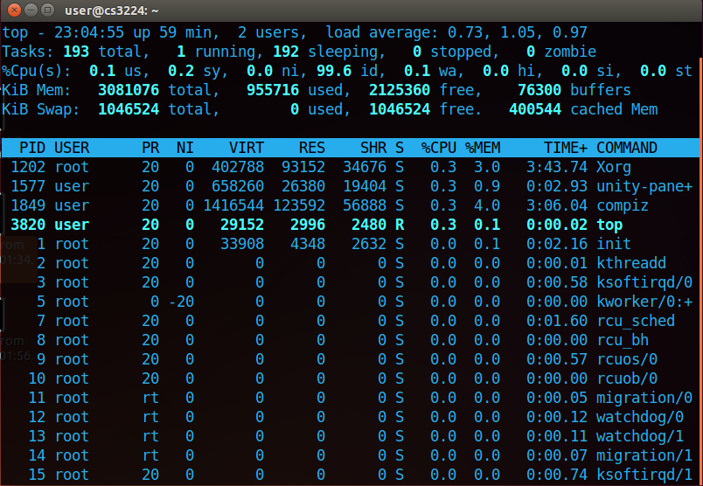
IN UBUNTU

Slide 3
GRASPING THE TOP’S INTERFACE

Slide 4
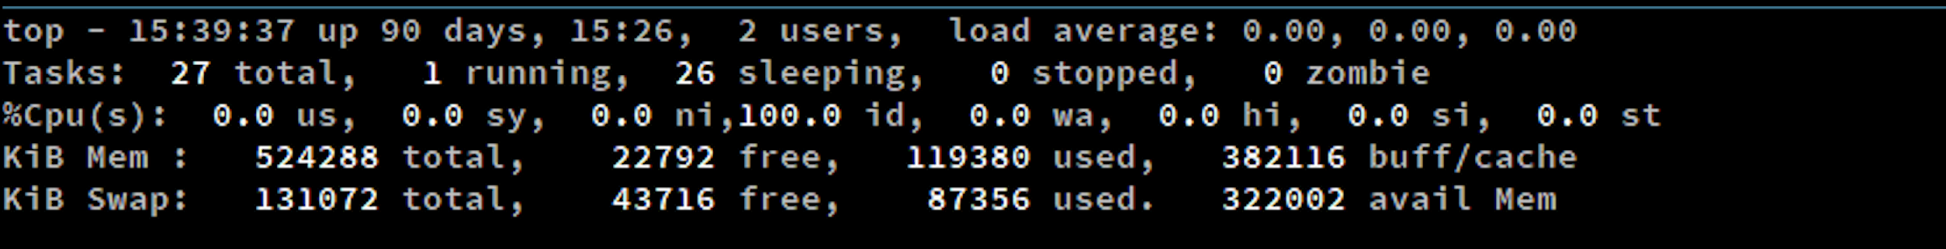
SUMMARY AREA

Slide 5
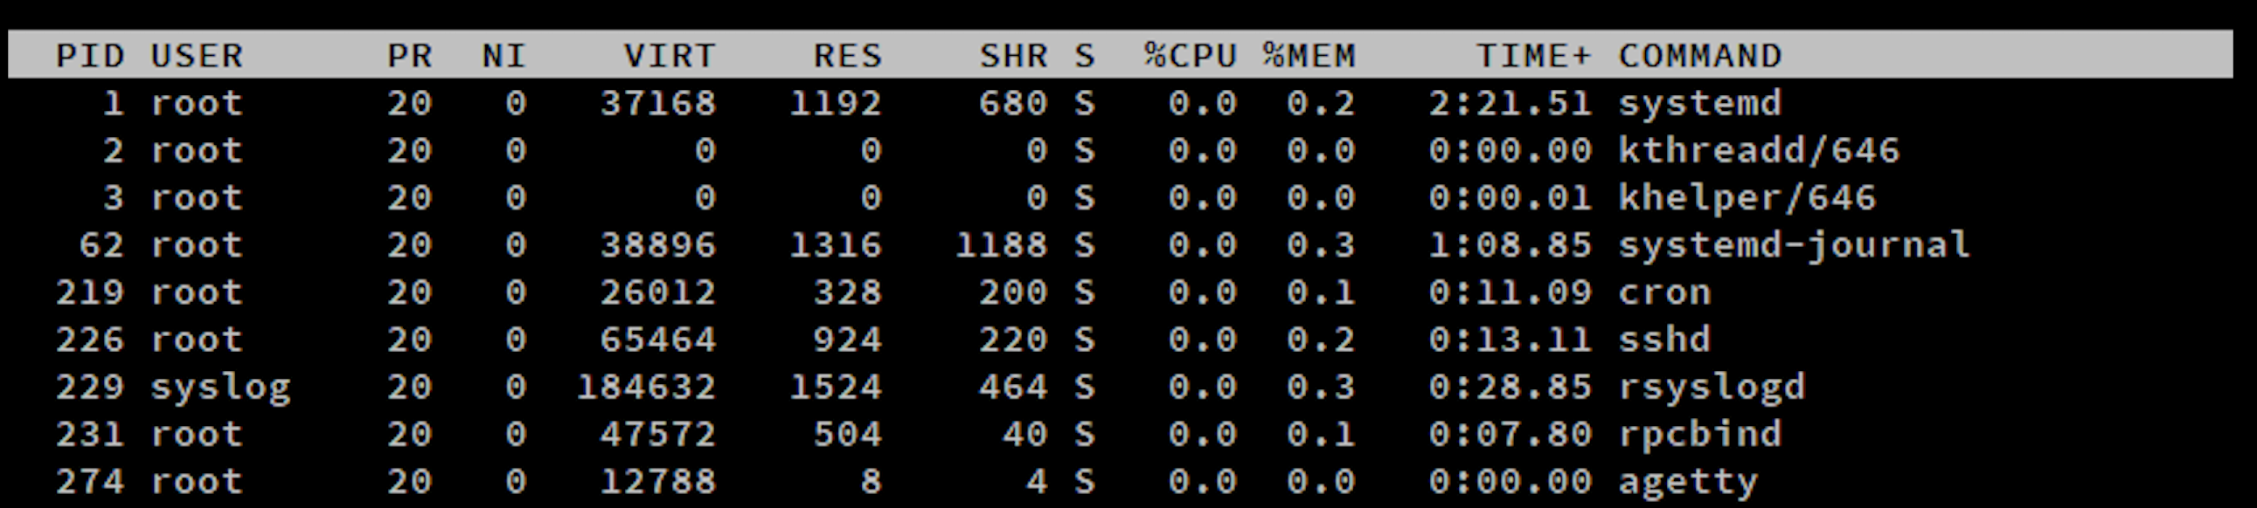
TASK AREA

Slide 6
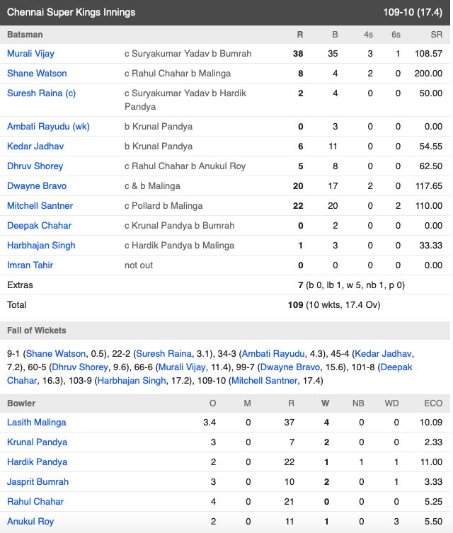

Slide 8
TOP VS PS

Slide 9
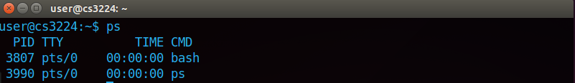

Slide 10
HOW DID WE IMPLEMENT TOP COMMAND?

Slide 11
PROCESS
proc.h-process structure
proc.c
TIME CALCULATIONS
def.h-ticks
MEMORY
memlayout.h-PHYSTOP
param.h-NPROC

Slide 12
WHAT IS THE DIFFICULTY IN ACCESSION?

Slide 13
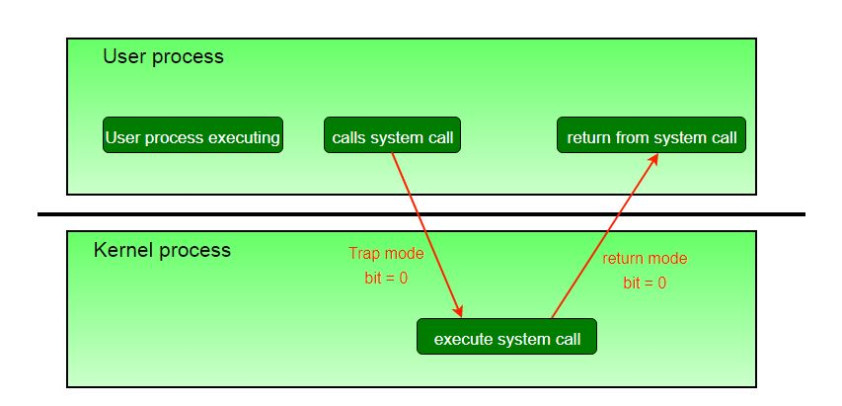

Slide 14
USER PROGRAM
makefile
SYSTEM CALL
sysproc.c
syscall.h
usys.S

Slide 15
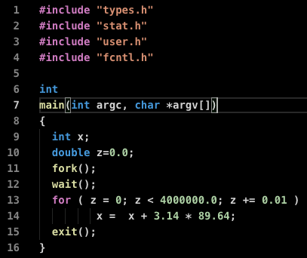
IMPLEMENTATION
SAMPLE.C

Slide 16
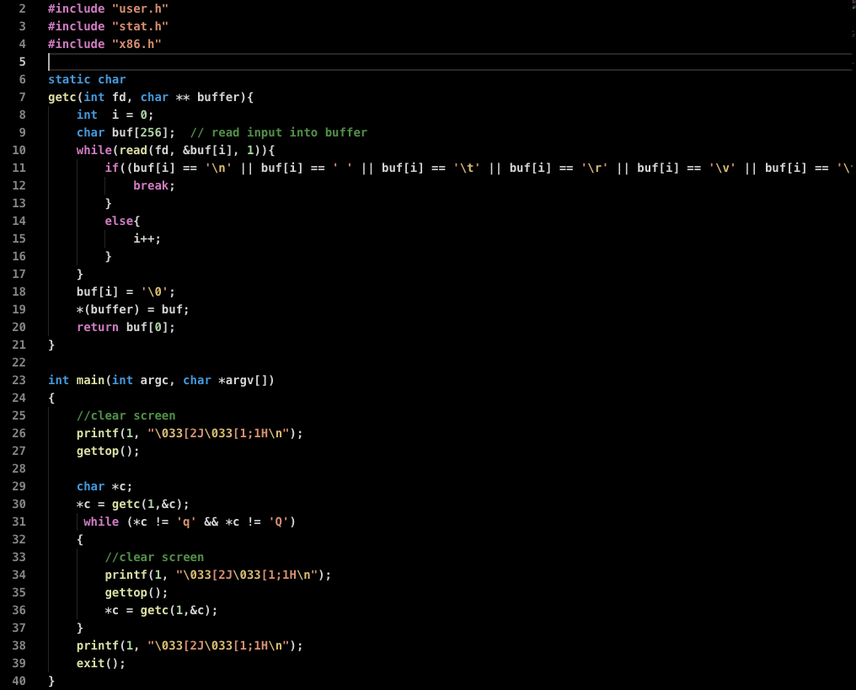
IMPLEMENTATION
TOP.C

Slide 17
TOP.C

Slide 18
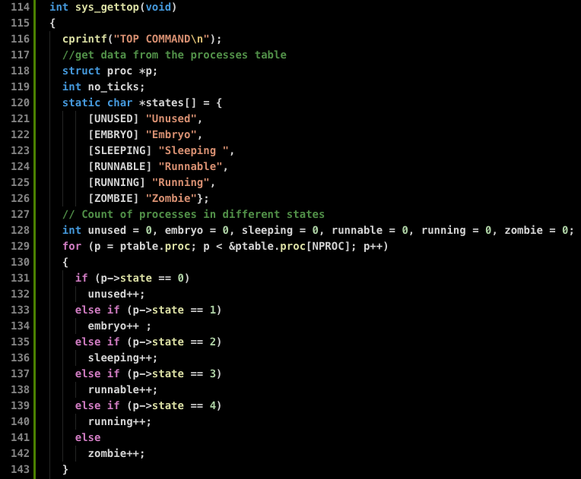
SYSPROC.C

Slide 19
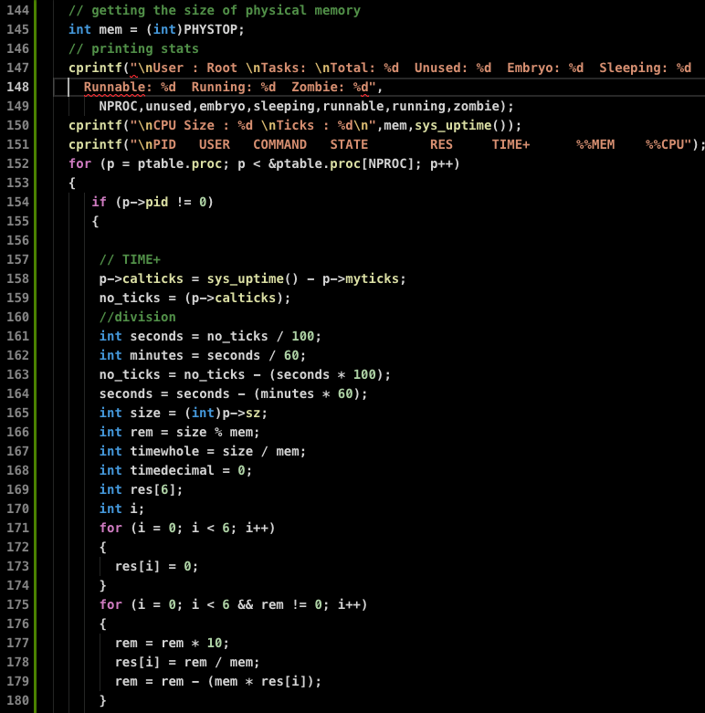
SYSPROC.C

Slide 20
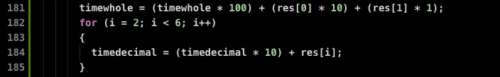
SYSPROC.C

Slide 21
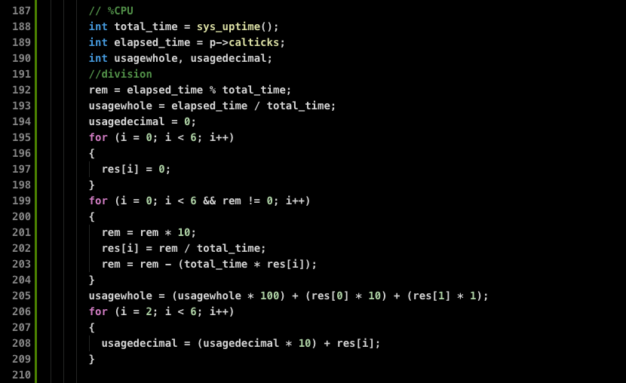
SYSPROC.C

Slide 22
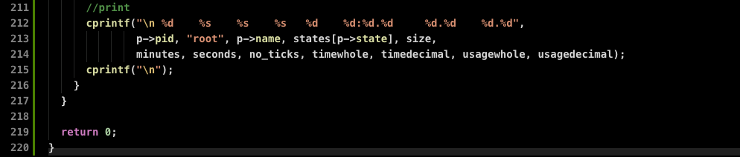
SYSPROC.C

Slide 23
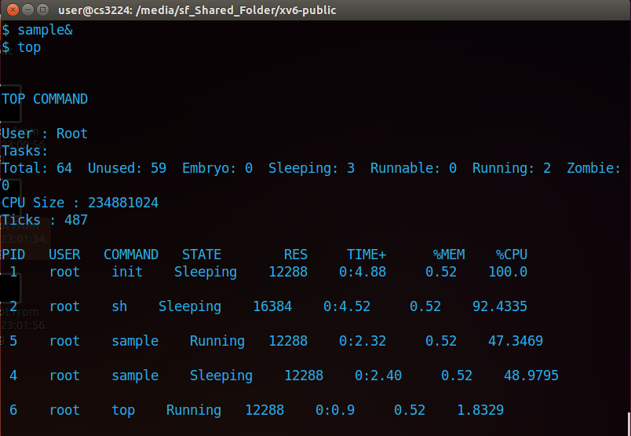
TOP IN XV6

Slide 24
GRACIAS

